Slide 2
Using the Reviewer App to Assess Student Work
Mark St. Andre
March 5, 2020

Slide 3
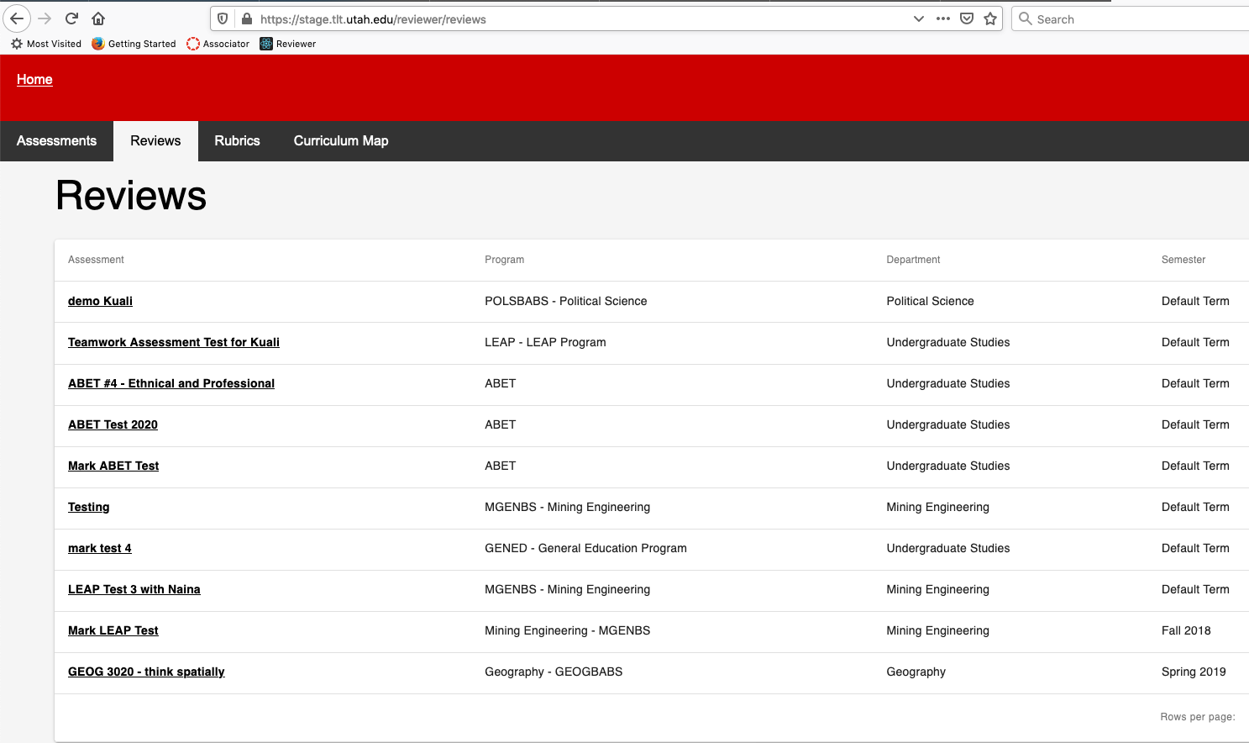
Click on the link in your email and you will be taken here: Click on “Gen Ed – Intercultural Knowledge and Competence”

Slide 4
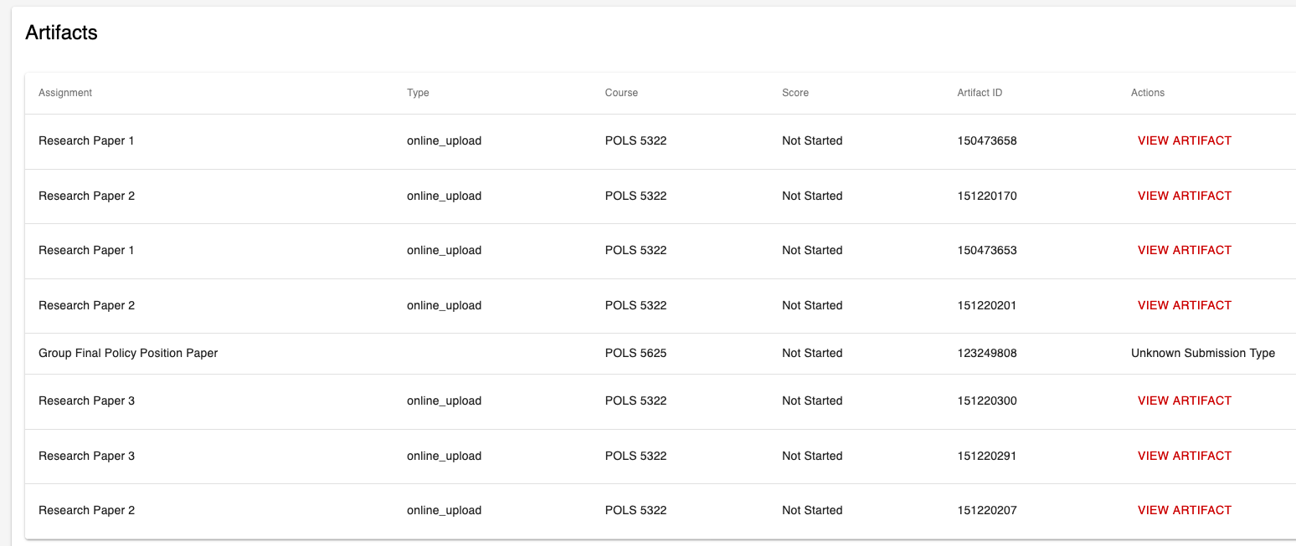
Scroll down to the Artifacts and click “Rate Artifact” to bring up the student work and begin doing your rating

Slide 5
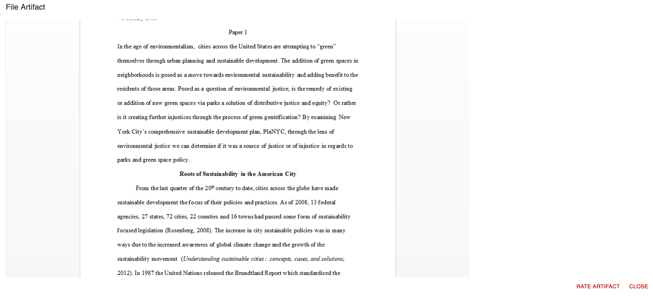
Read the Assignment Description at the top and scroll down to see the student work. Put mouse over assignment to scroll down through the assignment (If mouse is to the right it won’t work). Click “Rate Artifact”

Slide 6
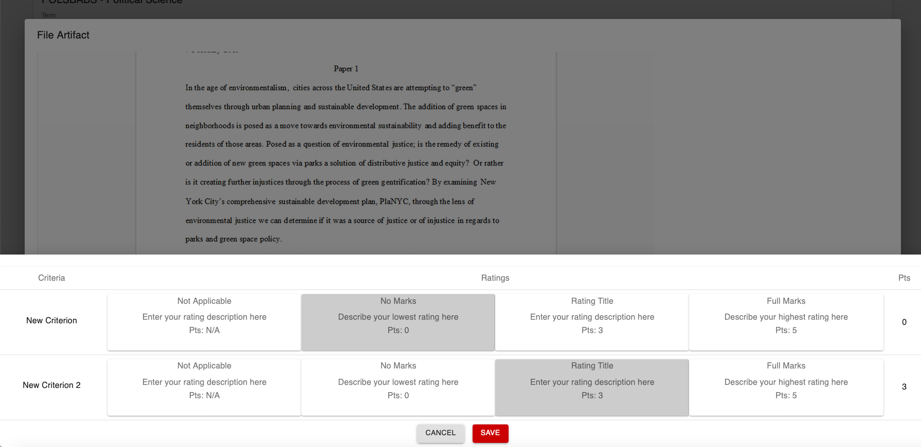
Clicking “Rate Artifact” will open the rubric. Select your ratings and click back and forth to the assignment as many times as you need to. You may need to scroll down inside the rubric to reach all the criteria. When done, click “Save” and go to the next artifact.

Slide 7
Questions? Call me (5-9876) or write (mark.standre@utah.edu) if you have any issues. Thank you!

